Slide 1
Data Encryption Standard (DES)
Lec06–Information Security
Prepared by Saadia Aziz © 20202saadia aziz saadia.aziz@riphah.edu.pk

Slide 2
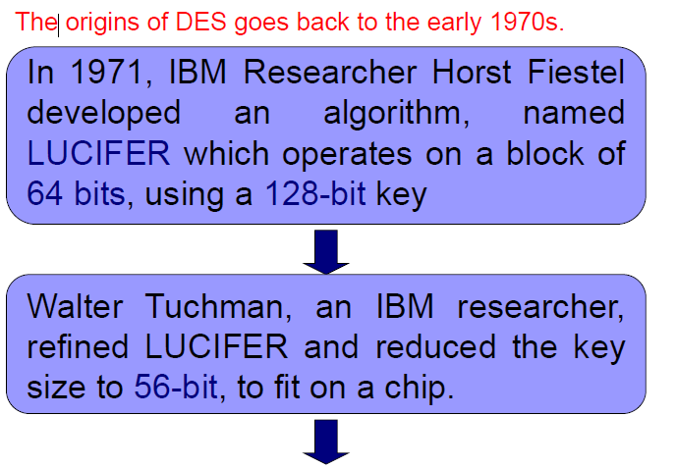
DATA ENCRYPTION STANDARD (DES)
History

Slide 3
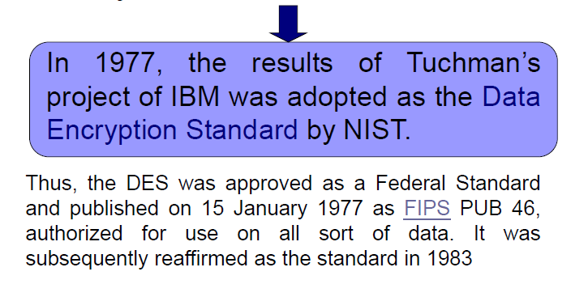
History (Cont’d)

Slide 4
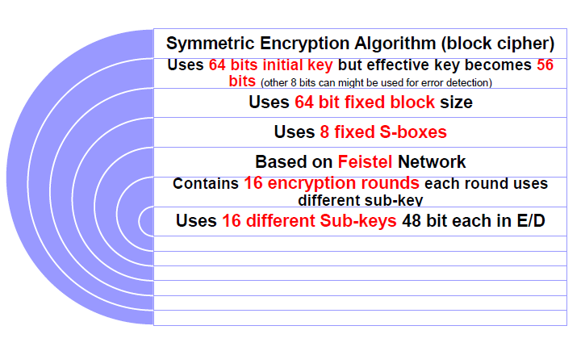
Data Encryption Standard

Slide 5
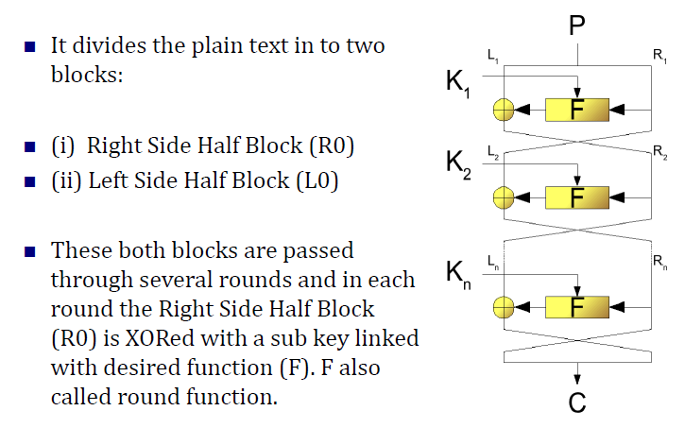
Fiestel Network OR Structure

Slide 6
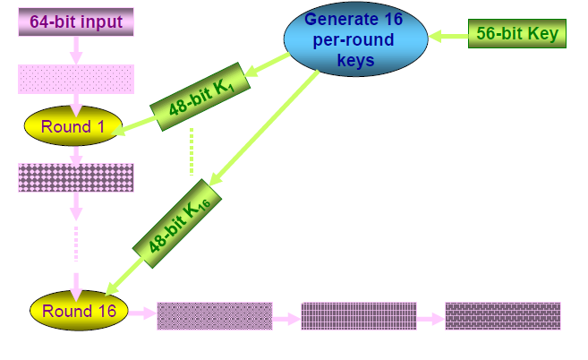
DES Overview-Encryption

Slide 7
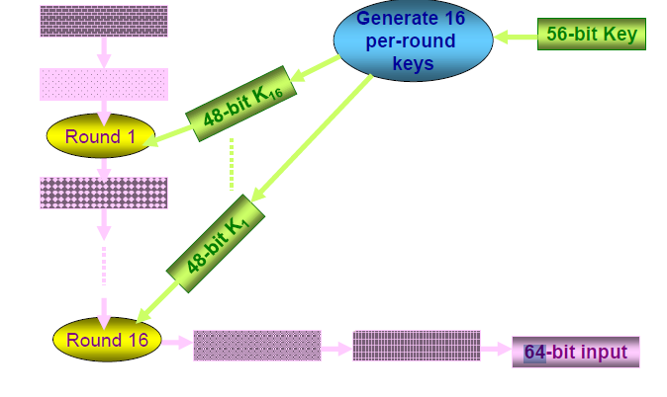
DES Overview-Decryption

Slide 8
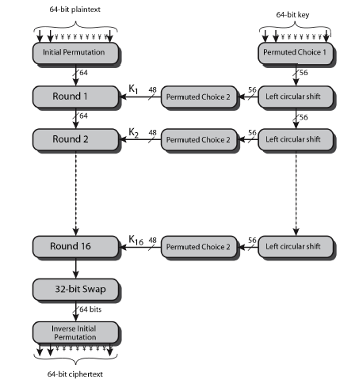
DES Encryption Overview

Slide 9
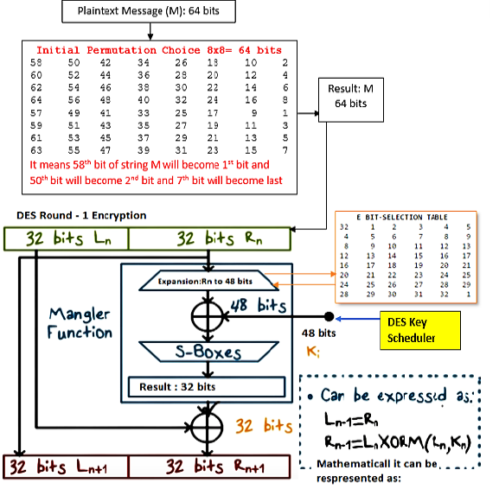
How DES Works

Slide 10
Vigenere Cipher Practice Example
Vigenère Cipher
Plaintext : GEEKSFORGEEKS
Keyword : AYUSH
Ciphertext : GCYCZFMLYLEIM

Slide 11
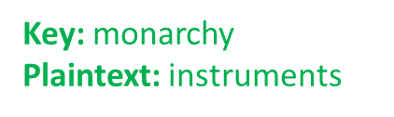
Playfair Cipher Practice Example

